Slide 1
QUIZ 4
12 Visualizing associations among two or more quantitative variables
13 Visualizing time series and other functions of an independent variable

Slide 2
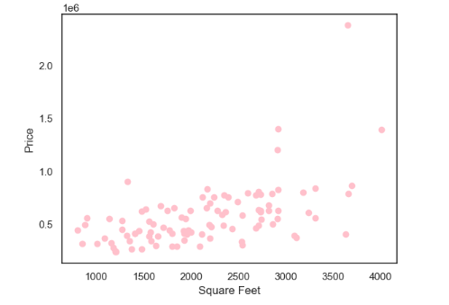
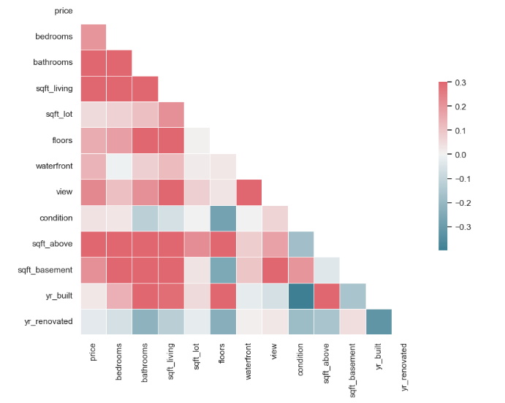
Scatter Plots and Correlograms
We have taken housing price dataset. In first plot, scatter plot is clustered around the line. This indicates there is a strong linear relation between price and square foot. So as the square foot increases price of the house tends to increase as well.
Second plot indicates price has positive co-relation with no of bedroom, bathroom and sq. foot of house, so price increase with increase in these variables and negative co-relation with year it is built and year renovated, so price decreases with increase in these variables.

Slide 3
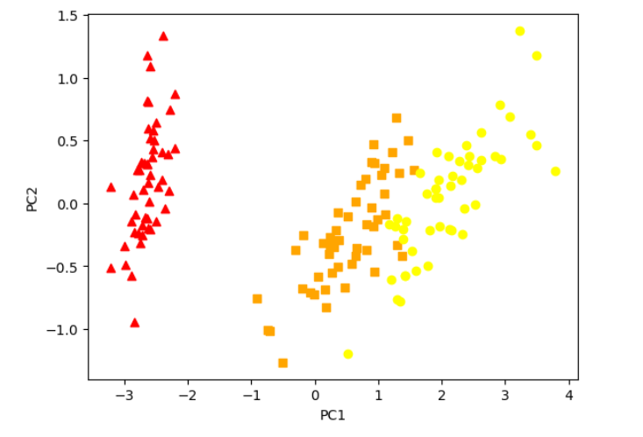
Dimension Reduction
Dimensionality reduction is the process of reducing the number of features or variables in a dataset while retaining as much useful information as possible.
I have taken Iris flower dataset which contains 4 dimensions. I have applied PCA to it to make it 2 dimensions. Here first two principal components, shows over 95% of the total variation, and we can see it shows clear separation between the three species of iris flowers. This suggests that the four original features may not be equally important in distinguishing between the different species.

Slide 4
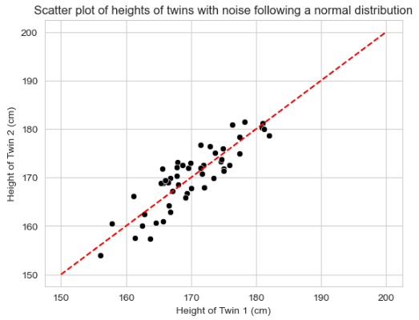
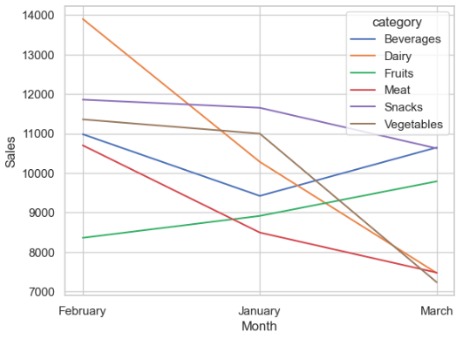
Paired Data
Category level Sales for January vs Category level Sales for February is an example.
In the above scatter plot, I have mapped heights of two twins, the noise follows a NORMAL distribution.
Above slopegraph indicates that the Dairy category had a severe loss when compared with the bump it had in February.

Slide 5
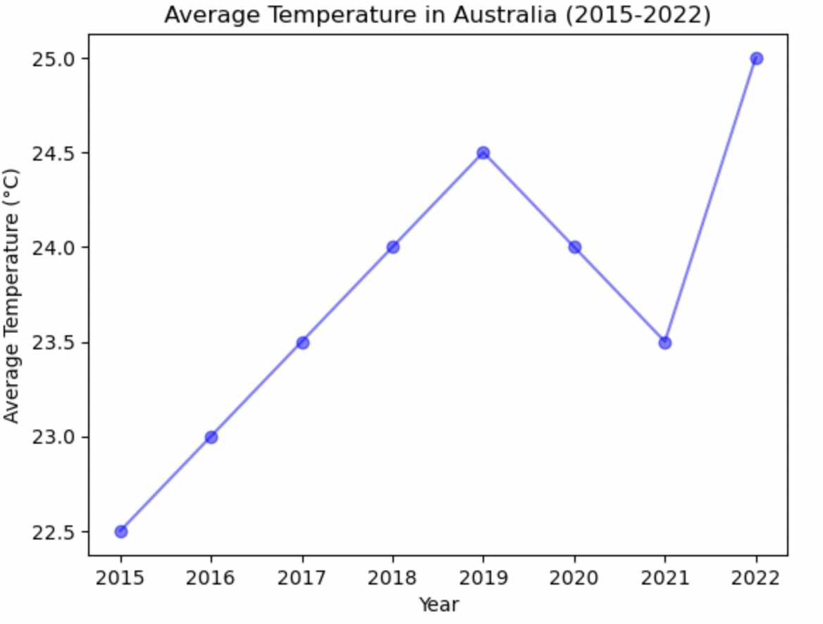
Individual Time Series
The plot indicates that the average temperature in Australia has been increasing gradually over the years with a dip in 2021.
The year 2019 had the highest average temperature of 24.5°C.
The year 2022 had the highest increase in average temperature with a peak of 25.0°C.

Slide 6
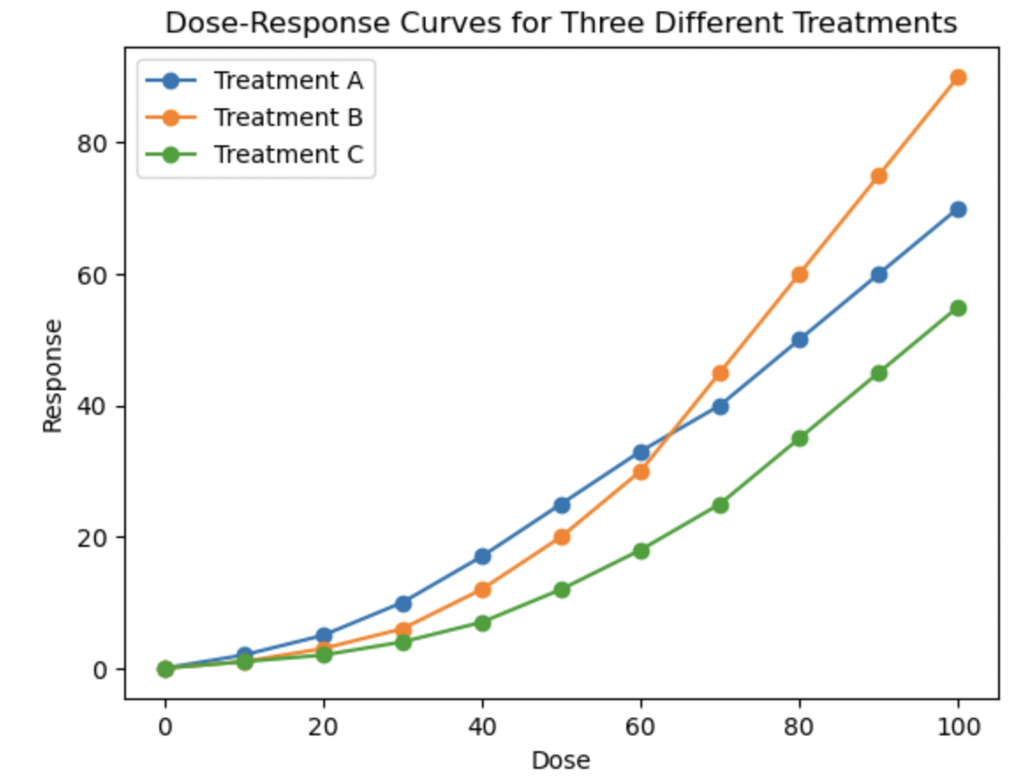
Dose- Response Curves
The plot shows the response (No. of Patients cured) of three different medical treatments (A, B, and C) to increasing doses of a treatment parameter.
Treatment A starts with the highest response, with a response of 0 at 0 dose and reaching a response of 70 at 100 dose and also has the steepest slope.
Treatment C starts with the lowest response, with a response of 0 at 0 dose and reaching a response of 55 at 100 dose and has the shallowest slope.
Treatment B falls in between Treatment A and C in terms of the starting point and slope. It has a response of 0 at 0 dose and reaches a response of 90 at 100 dose.

Slide 7
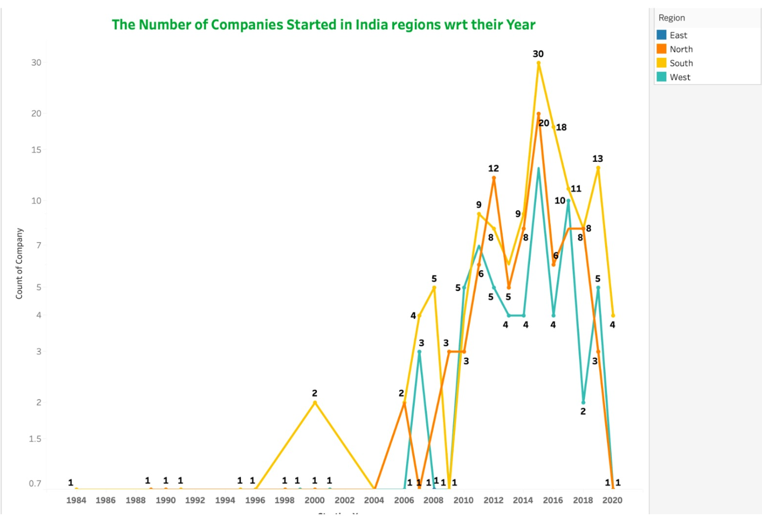
Multiple Time Series
The visualization reveals the time trend of years that is in 2015, there was a significant increase of almost three times the number of startups.
The data indicates that South India is currently the leading region or startups, followed by North India, and then West India.
Conversely, the East region has the least number of startups, with only one recorded in 2008.
It is worth noting that the graph also depicts a decline in the number of startups after 2015, extending to 2020.

Slide 8



Thank you!

